Slide 1



Health Research, Inc. – Interview Presentation
COVID-19 Global Surveillance 2025
Gayathri Karthikeyan
BDS, MPH
13 August , 2025

Slide 2



Health Research, Inc. – Interview Presentation
Project Overview
Objective: Identify high-risk countries for COVID-19 in 2025 using epidemiologic metrics.
Data Source: Kaggle Open Data Repository
Approach: Data cleaning → SQL queries → Macros → Statistical analysis → Predictive modeling → Visualization.

Slide 3


Health Research, Inc. – Interview Presentation
Initial Data Cleaning (Excel)
Goal: : Prepare dataset for smooth import and processing in SAS
Key Actions:
Renamed variables – removed special characters unreadable by SAS
Corrected country names – filled in incomplete entries
Formatted numeric fields – removed commas, converted to numeric type
Handled missing values – converted all blanks and “N/A” to . (SAS missing)

Slide 4
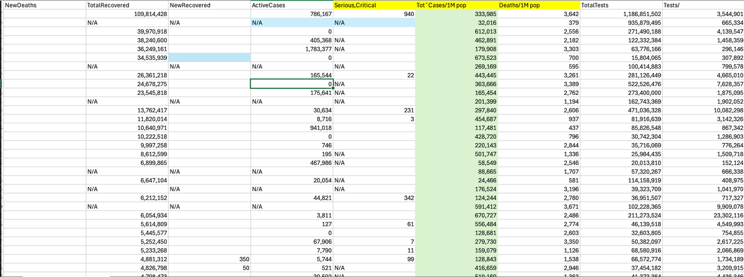
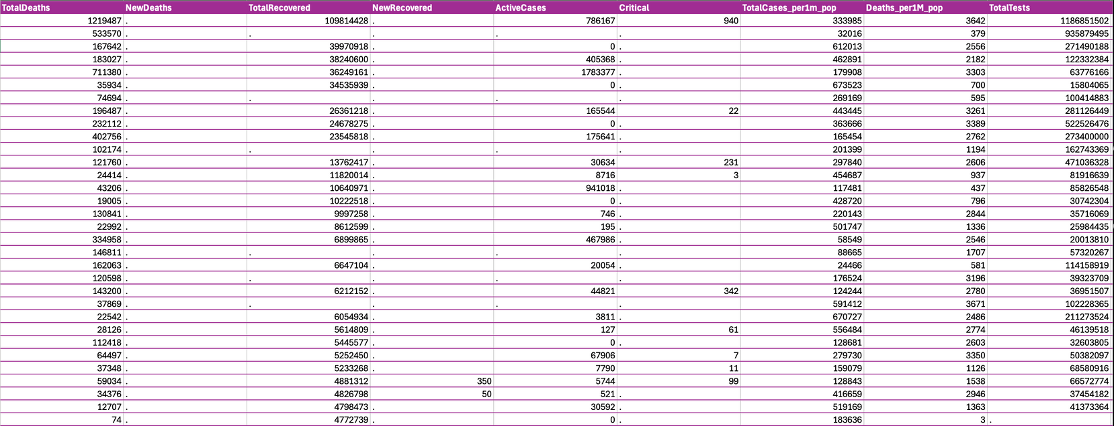
Health Research, Inc. – Interview Presentation
Before
After

Slide 5

Health Research, Inc. – Interview Presentation
Analysis-Ready Datasets
Missingness Check
Used proc means n nmiss on key variables: TotalCases, TotalDeaths, TotalRecovered, Deaths_per1M_pop, Population
Counted non-missing and missing values to identify data gaps before analysis
Flag-Based Eligibility
CFR_flag: Requires TotalCases and TotalDeaths
RR_flag: Requires TotalCases and TotalRecovered
HR_flag: Requires Deaths_per1M_pop
Feature Engineering
log_pop = log(Population + 1) → stabilizes skew, allows for zero values
Purpose-Built Subsets
project.cfr_model_data → rows with CFR_flag = 1
project.rr_model_data → rows with RR_flag = 1
project.highrisk_data → rows with HR_flag = 1
Why This Design
Transparent criteria per outcome
Preserves maximum usable data for each analysis
Reproducible exclusions for auditability

Slide 6
Health Research, Inc. – Interview Presentation
SAS SQL Queries
Goal: : Extract key descriptive statistics and rankings for COVID-19 impact assessment
Key Analyses Performed:
Continent-Level Summary
Total cases, total deaths, average deaths per 1M population
ordered by total cases (highest first)
Top/Bottom Rankings
Cases per 1M population: Top 10 countries
Deaths per 1M population: Top 10 countries
Case Fatality Rate (CFR %): Top 5 & Bottom 5
Recovery Rate (%): Top 5 & Bottom 5
Tests per 1M population: Top 5 & Bottom 5

Slide 7

Health Research, Inc. – Interview Presentation
SAS Macro
Goal: Automate repetitive COVID-19 data analysis and visualization tasks
Macros Created:
%covid_filter(var, threshold)
Filters countries where a numeric variable exceeds a user-defined threshold
Example: Countries with TotalCases > 1,000,000
%above_avg(var)
Returns countries where a variable is above the global average
Example: Above-average TotalCases
%histogram(var)
Generates a histogram and summary statistics for a numeric variable
Provides mean & standard deviation inset on the plot
%compare_vars(var1, var2)
Lists countries where one metric exceeds another
Example: TotalCases > TotalDeaths (useful for ratio checks and anomalies)

Slide 8

Health Research, Inc. – Interview Presentation
SAS Statistical Analysis
Goal: Explore COVID-19 patterns and identify predictors of high-risk countries
Descriptive & Exploratory Analysis
proc means → Summary statistics (mean, median, min, max, std) for numeric variables
proc freq → Frequency counts for categorical variables (e.g., Continent)
%histogram(var) macro → Visualize numeric variable distributions with mean & SD inset
Inferential Analysis
Wilcoxon Rank-Sum Test (non-parametric)
Compared Deaths_per1M_pop between High-Risk vs Low-Risk groups
Median cutoff: 869 deaths per 1M used for classification
Chosen because data was not normally distributed
Predictive Modeling — Logistic Regression
Model 1: High-Risk ~ CFR + log(Population)
CFR = TotalDeaths / TotalCases
Model 2: High-Risk ~ RecoveryRate + log(Population)
RecoveryRate = TotalRecovered / TotalCases
log_pop used to reduce skewness and handle large population differences

Slide 9

Health Research, Inc. – Interview Presentation
ODS Export to Excel
Goal: Compile and organize key outputs into a structured Excel report for easy review and integration into dashboards
Export Setup
Sheets Generated:
Cases > 100k — Countries with more than 100,000 cases (ranked)
Continent Summary — Total cases, total deaths, average deaths per 1M
Top 10 Deaths per 1M — Highest mortality burden per population size
Cases vs Global Avg — Comparison and deviation from global case average
Wilcoxon Test — High-Risk vs Low-Risk Deaths_per1M_pop
Logistic CFR — Predicting high-risk from CFR + log(Pop)
Logistic RR — Predicting high-risk from Recovery Rate + log(Pop)

Slide 10

Tableau Dashboard
Goal: Transform exported SAS outputs into an interactive visual summary for quick insights
High Case Burden (per 1M population):
France, Martinique, Andorra, Slovenia, and others lead the Top 10 Total Cases per 1M list
High Mortality Burden:
Peru, Bulgaria, Hungary, Bosnia & Herzegovina appear in Top 10 Total Deaths per 1M
Case Fatality Rate (CFR):
Highest CFR — Yemen, MS Zaandam, Sudan, Syria, Western Sahara
Lowest CFR — Brunei, DPRK, Iceland, South Korea, Singapore
Recovery Rates:
Highest — DPRK, Falkland Islands, South Korea, Singapore, Vatican City
Lowest — Algeria, Brunei, Egypt, Lebanon, Uganda
Testing Rates:
Highest Testing per 1M — Austria, Bermuda, Denmark, Gibraltar, UAE
Lowest Testing per 1M — Algeria, DRC, Eritrea, Niger, Syria
Continental Trends:
Europe dominates high case and high death lists
Africa and Oceania have lower proportional representation in top burden categories

Slide 11
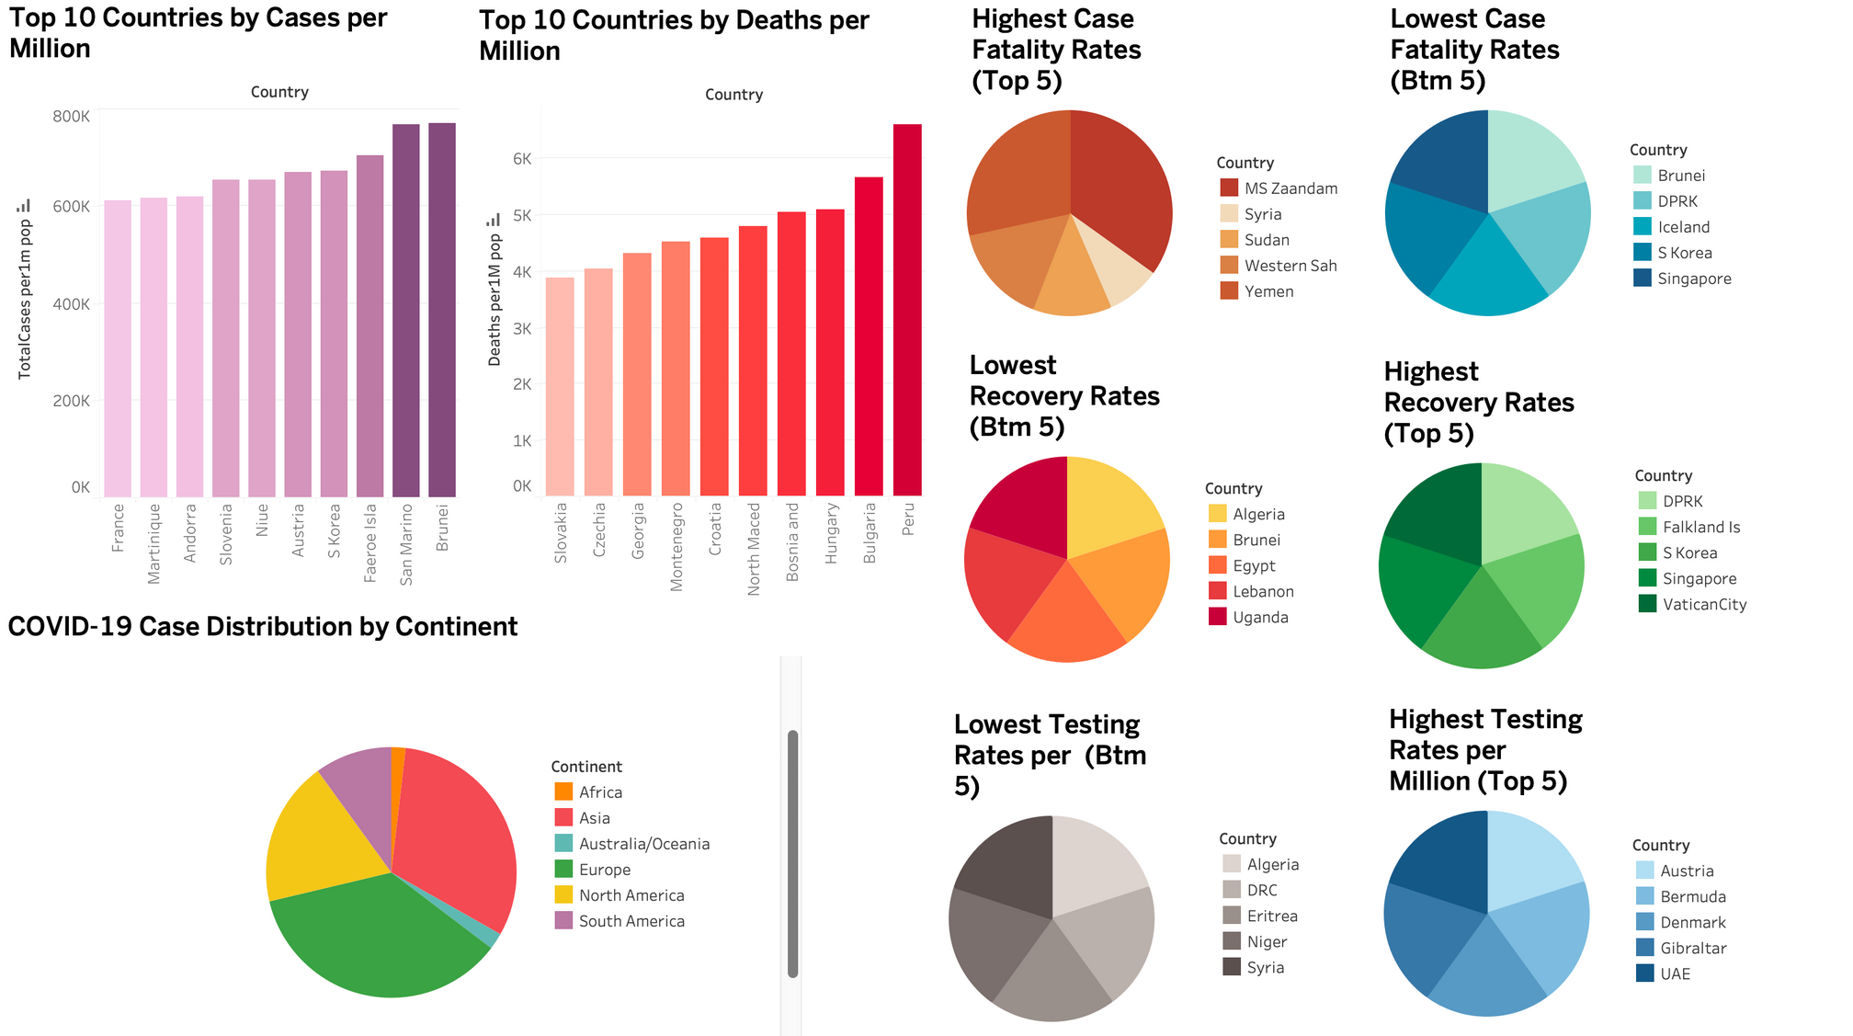
Tableau Dashboard
Health Research, Inc. – Interview Presentation

Slide 12

Health Research, Inc. – Interview Presentation
Explanations and Impliction
High Cases per 1M (e.g., France, Martinique, Andorra):
Higher testing capacity → more detection of cases
Smaller populations amplify per-capita rates
Potential large outbreaks in urban clusters or tourist hubs
High Deaths per 1M (e.g., Peru, Bulgaria, Hungary):
Older population demographics increasing vulnerability
Strain on healthcare systems during peak surges
Possible delays in seeking care or limited ICU capacity
High CFR (e.g., Yemen, MS Zaandam, Sudan):
Limited healthcare access and critical care capacity
Low testing leading to undercounted mild/asymptomatic cases (inflates CFR)
Possible reporting lags or data quality issues
Low CFR (e.g., Brunei, DPRK, Singapore):
Strong early containment and treatment protocols
Younger population demographics
Broader testing detecting more mild cases, lowering CFR
High Recovery Rates (e.g., DPRK, Falkland Islands, Singapore):
Effective case management and follow-up systems
Low proportion of severe cases due to early detection
Data definition differences (when “recovered” is recorded)
Low Testing Rates (e.g., Algeria, DRC, Eritrea):
Resource constraints limiting diagnostic capacity
Political instability or logistical barriers to widespread testing
Under-detection of true case burden
Continental Patterns:
Europe’s dominance in high case/death categories could reflect both better surveillance and severe outbreak waves
Lower African representation may be due to under-testing rather than low true burden

Slide 13

Health Research, Inc. – Interview Presentation
GITHUB LINK TO CODE
https://github.com/gayathri1913/COVID19_Global_Surveillance_2025

Slide 14

Health Research, Inc. – Interview Presentation
Thank You
857-999-5393
gk1998@bu.edu
Portfolio website: https://sites.google.com/bu.edu/gayathri-karthikeyan/home

